Slide 1
WSC Quant
Trading strategy- Overnight Carry

Slide 2
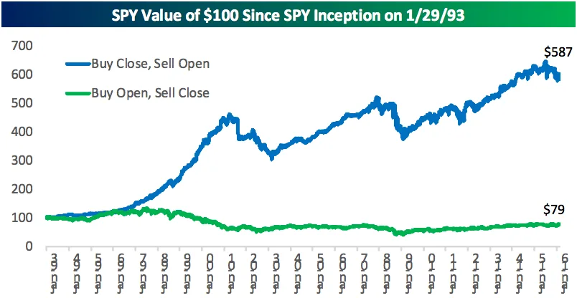
What exactly is Overnight carry ?
The Overnight carry trading strategy is a basic trading strategy wherein you buy the index at close and sell it at the open of next day.
The idea was first implemented on the SPY by the Bespoke Investment Group and did seem to outperform the index.

Slide 3
Intuition behind the strategy:
Why sell close and buy open?
The intuition behind this strategy is that alpha occurs post trading hours and stocks fall during the trading hours.
Stocks/Indices rise relatively more post market and fall further during trading hours.

Slide 4
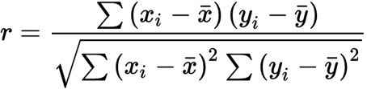
Some things to know:
Scatter plots:
Scatter plots are used to plot data points on a horizontal and a vertical axis in the attempt to show how much one variable is affected by another.
Correlation:
In statistics, correlation or dependence is any statistical relationship, whether causal or not, between two random variables.

Slide 5
What are we going to do?
Try this trading strategy on Indian indices and stocks and compare returns.
Look for various factors that can be considered for improving the performance of the strategy.

